Slide 1





RECOSYS
REstaurant
reCOmmendation SYStem
RECOSYS

Slide 2



Develop a restaurant recommendation system that analyzes past reviews sentimentally, According to that provide suggestions based on location within a 5 km radius for enhanced user dining experiences.
PROBLEM STATEMENT

Slide 3
OBJECTIVES
To develop a robust restaurant recommendation system for Pune City. And applying sentiment analysis techniques to the extracted reviews for calculating the polarity and subjectivity of the reviews.
Comparative analysis of sentimental analysis techniques.
Formulate the criteria for rating based on polarity.
Create a user interface and provide it to users for ease of use.

Slide 4
DATASET
Pune City’s restaurant data consists of around 1258 restaurants and 196 cuisine/Category types which is scraped from Google Maps.
The dataset contains 7,54,019 rows and 21 columns.
The dataset contains the following features
Stars, ReviewID, title, street, text, total score, lat/long, categories/0, categories/1, etc.

Slide 5
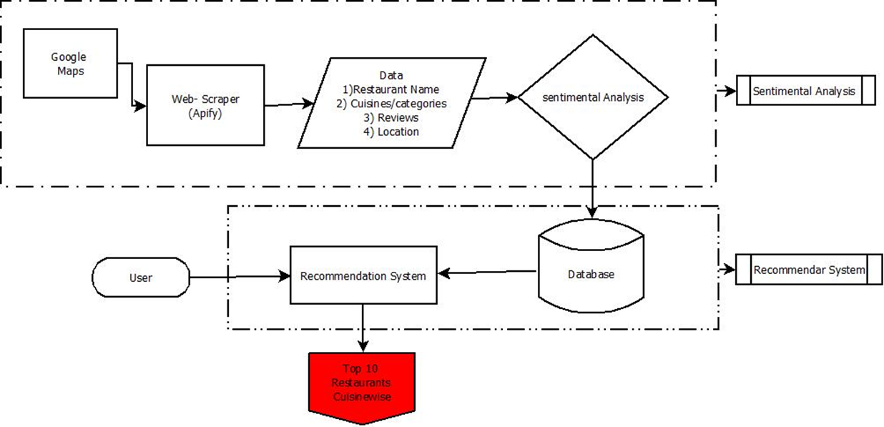
RECOSYS ARCHITECTURE
Google Maps
Web-scraping
Data Preprocessing
Sentimental Analysis
Srating
Recommendation System
User Interface

Slide 6
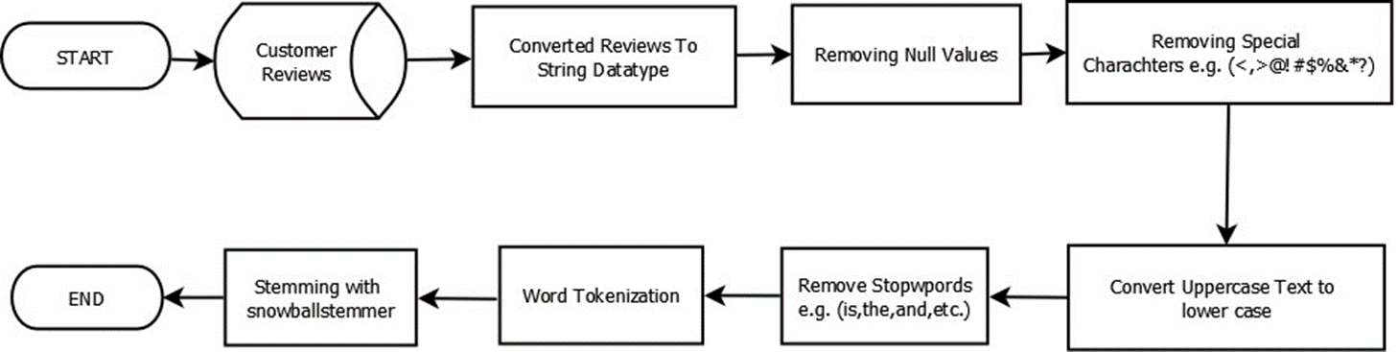
DATA PREPROCESSING
• Combining and Finding unique Cuisines
• Converting Datatypes
Text Preprocessing

Slide 7


Sentiment Analysis: Unveiling Emotions with Polarity,
Subjectivity, and Segmentation
•Polarity: Polarity relates to a text's sentiment or emotional orientation, which is commonly described as positive, negative, or neutral. The polarity score range is in [-1,1].
•Subjectivity: Subjectivity classification in sentiment analysis seeks to evaluate whether a text represents subjective or objective information. The Range for Subjectivity is [0,1].
•Segmentation: Segmentation entails breaking down the text into smaller parts. Segmentation classifies text as either positive, negative, or neutral.

Slide 8
NEW STAR RATING
Here,
Score: Polarity score
Lower limit: polarity lower limit which is -1.
Upper limit: polarity upper limit which is 1.
newscore lower limit: It is a new rating lower score which is 0.
newscore upper limit: It is a new rating upper score which is 5.

Slide 9
MODEL BUILDING
•Balancing data with the Resampling method:
•Train-test split
•Models:
I. Random forest Classifier
It is an ensemble learning method that combines multiple decision trees to make more accurate and robust predictions.
•Hyperparameters used:- max_deapth, n_estimators

Slide 10
MODEL BUILDING
II. Multinomial Model
It is a variant of the Naive Bayes classifier that takes into account the occurrence frequencies of words in each class to make predictions. also calculate prior probability and then with the help of bayes Theorem predict classes.
•Hyperparameters used:- alpha, fit_prior
III. ExtraTreesClassifier
The extra trees algorithm, like the random forests algorithm, creates many decision trees, but the sampling for each tree is random, without replacement.
IV. Logistic Regression
Logistic Regression is a simple yet effective classification algorithm. it decides decision boundary ased on the calculated probabilities, a decision boundary is set (usually at 0.5 probability) to separate the positive class from the negative class.

Slide 11
MODEL BUILDING
V. KNN classifier
KNN is a lazy learning algorithm, meaning that it does not perform an explicit training phase like other models. Instead, it stores the entire dataset and waits for new samples to be classified.
Algorithm use, Euclidean distance or cosine similarity to create clusters.
•Hyperparameters used:- n_neighbours
VI. SVM (SVC)
SVM or SVC is a powerful and widely used machine learning algorithm for binary and multi-class classification tasks. It Divides classes using hyperplane.
•Model Evaluation techniques

Slide 12
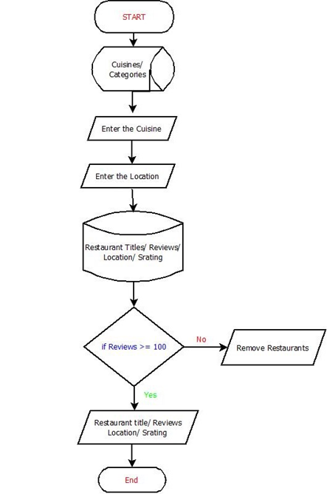
RECOMMENDATION SYSTEM
Condition 1:
RESTAURANT REVIEWS/ TEXT >= 100
Using Groupby Extract some Features
Then applying aggregate functions on that

Slide 13
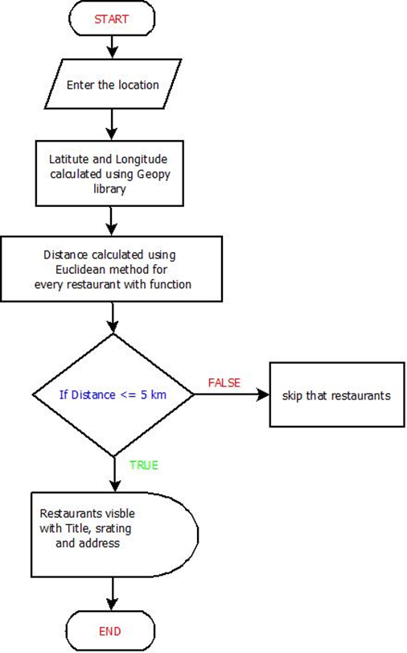
RECOMMENDATION SYSTEM
Condition 2:
RESTAURANT DISTANCE <=5
Distance is calculated using geopy.geocoders libraries Nominatim function.
Taking users convinient or live location
Distance calculated using haversine Formula

Slide 14


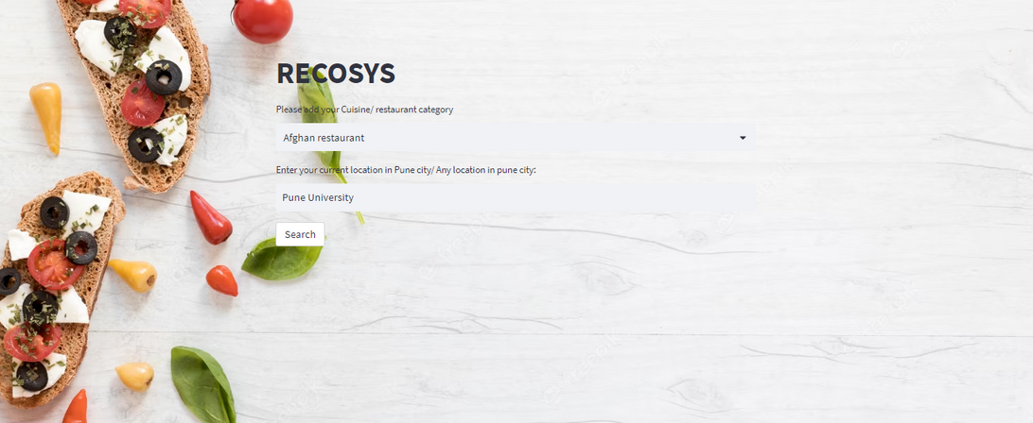
User InterFace
Used Libraries and Softwares:
Streamlit Library
Pickle File
Ngrok Software

Slide 15
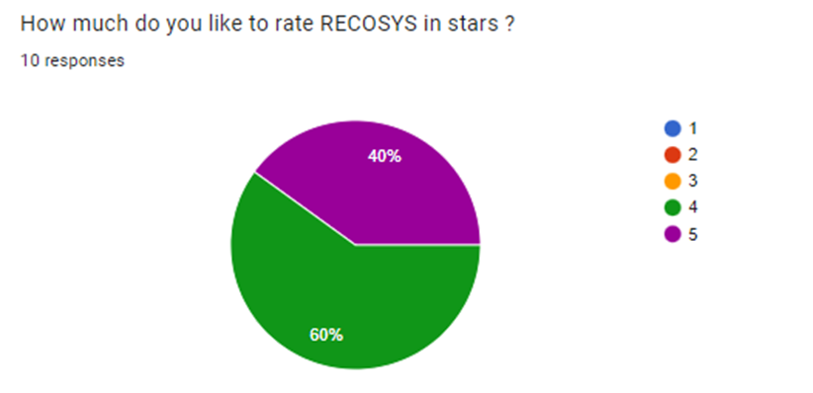
SUBJECTIVE ANALYSIS
Create Questionary
and Share Through google Form.
e.g. How much do you like to rate RECOSYS in stars?

Slide 16
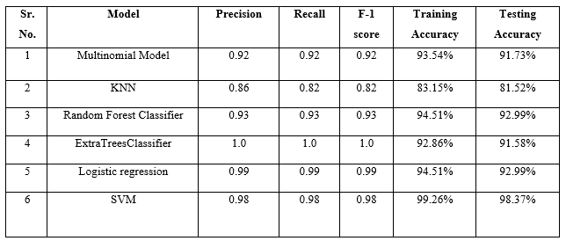
RESULTS
We applied Six models here from that we got the highest accuracy for SVM which is around 98% .
SVM gives highest accuracy because follows effective seperation of data, handle high dimension data, and main aim is global optimum solution.

Slide 17
CONCLUSION
The RECOSYS successfully leverages sentiment analysis with a unique formula to provide personalized recommendations. By incorporating various features, including restaurant addresses and more, the system offers a comprehensive and user-friendly recommendation platform, enhancing the overall user experience.
From Models got the highest accuracy for SVM which is around 98% .
From subjective analysis also we get positive responses we can conclude at this stage, the system looks promising. also the project's frontend interface facilitated seamless user interaction.

Slide 18
FUTURE WORK
Future work involves evolving the current RECOSYS, which currently focuses on Pune city, to be updated and scaled for nationwide or global coverage.
we can add multiple features aspects like intricate average price per meal and restaurants images in data so users also take advantage. Also we can add filters.
work on distance here it gives direct distance so try to calculate navigated distance.
We take static data for dynamic data we have to work on it.

Slide 19
REFERENCES
lham Asani, Hamed Vahdat-Nejad, and Javad Sadri, "Restaurant recommender system based on sentimental analysis",2021.
Parandham G and Mr. Raghavendra R, "Sentimental Analysis On Restaurant Reviews.",2021.
Murtadha M. Hamad, Mohanad Ahmed Salih, and Refed Adnan Jaleel, " Sentiment Analysis of Restaurant Reviews in Social Media using Naïve Bayes ",2021.
Murtadha M. Hamad, Mohanad Ahmed Salih, and Refed Adnan Jaleel, " Sentiment Analysis of Restaurant Reviews in Social Media using Naïve Bayes ",2021.
Jing Tian, Wushour Slamu Miaomiao Xu, Chunbo Xu, and Xue Wang, "Research on Aspect-Level Sentiment Analysis Based on Text Comments",2022.

Slide 20

THANK YOU FOR YOUR ATTENTION

